Slide 1
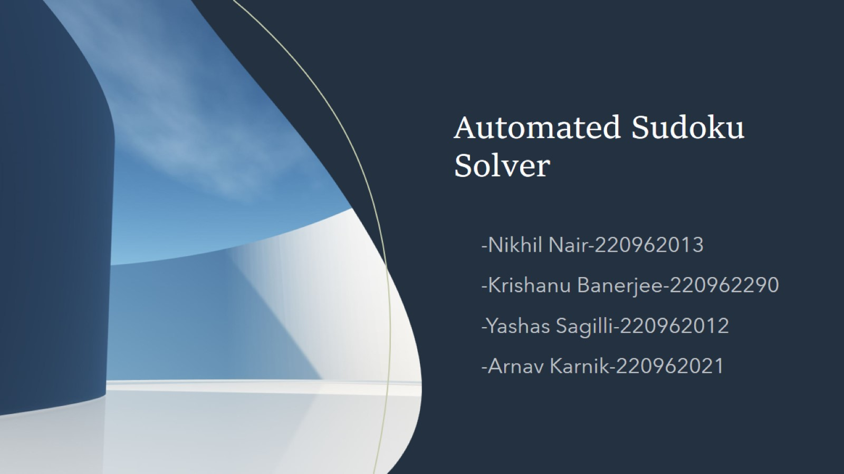
Automated Sudoku Solver

Slide 2
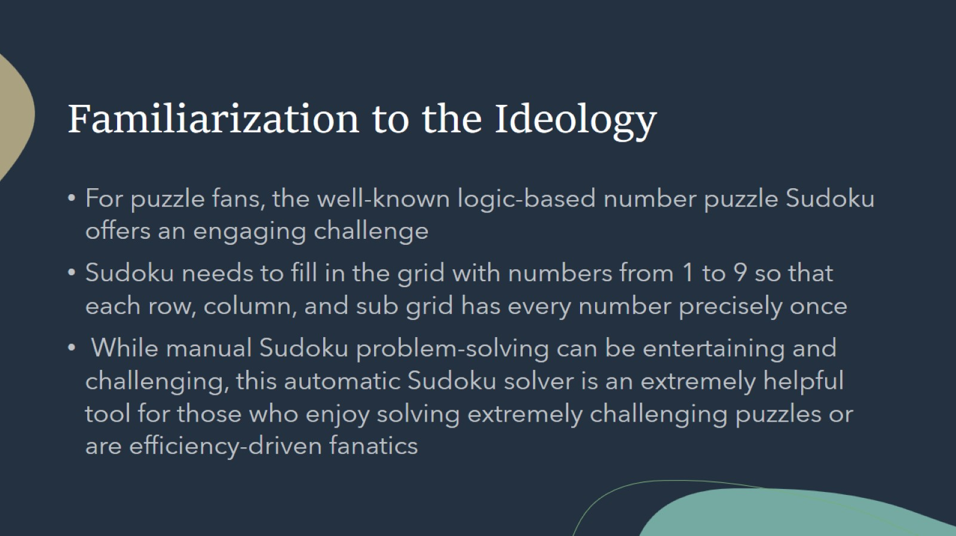
Familiarization to the Ideology

Slide 3
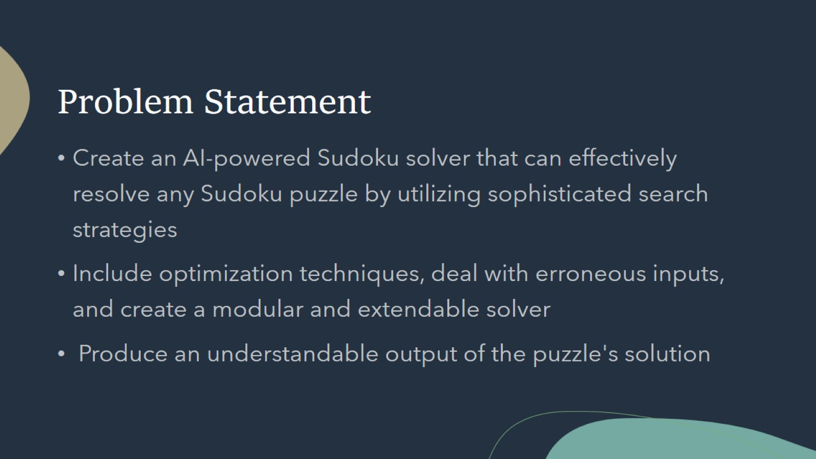
Problem Statement

Slide 4
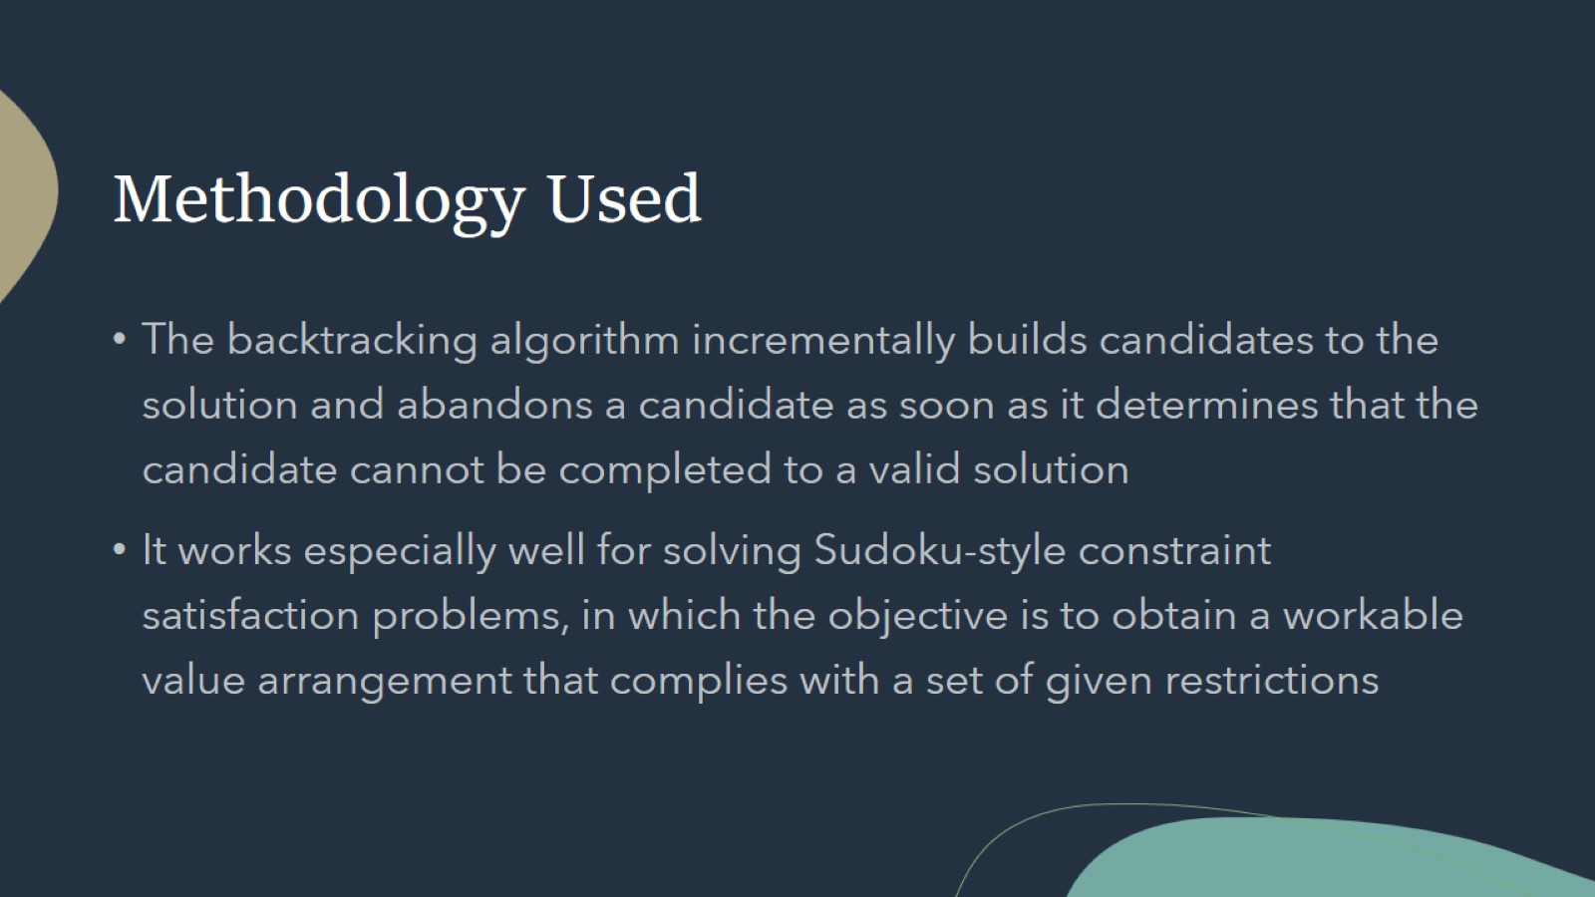
Methodology Used

Slide 5
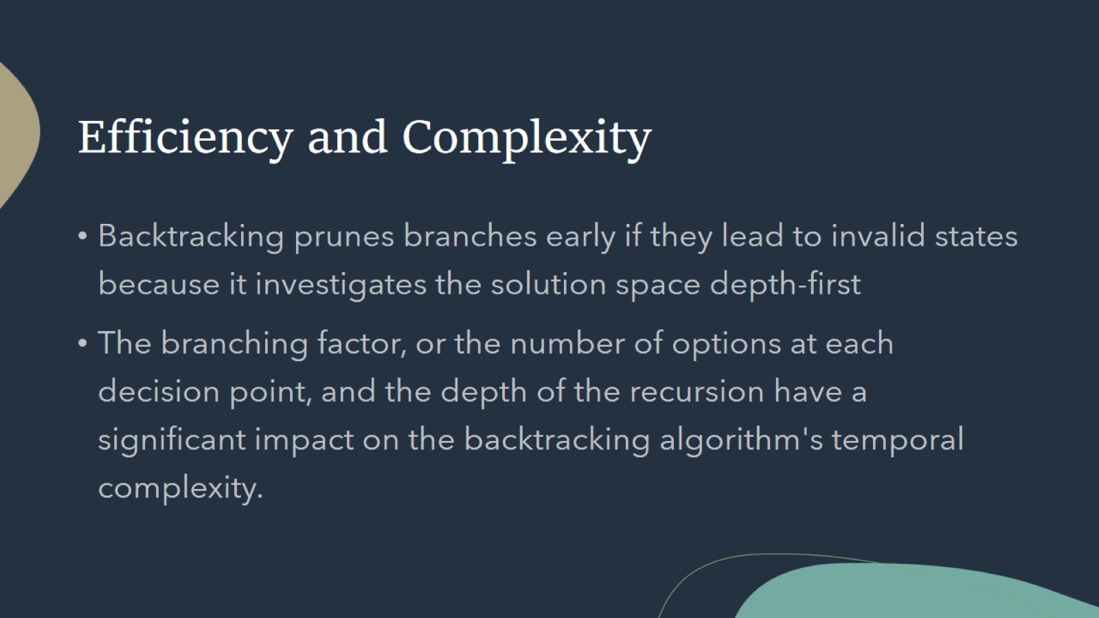
Efficiency and Complexity

Slide 6
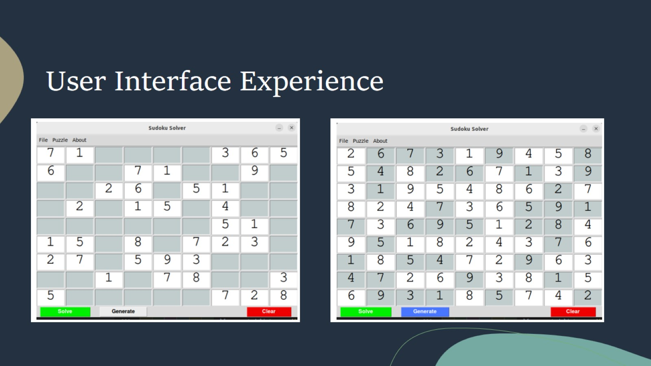
User Interface Experience

Slide 7
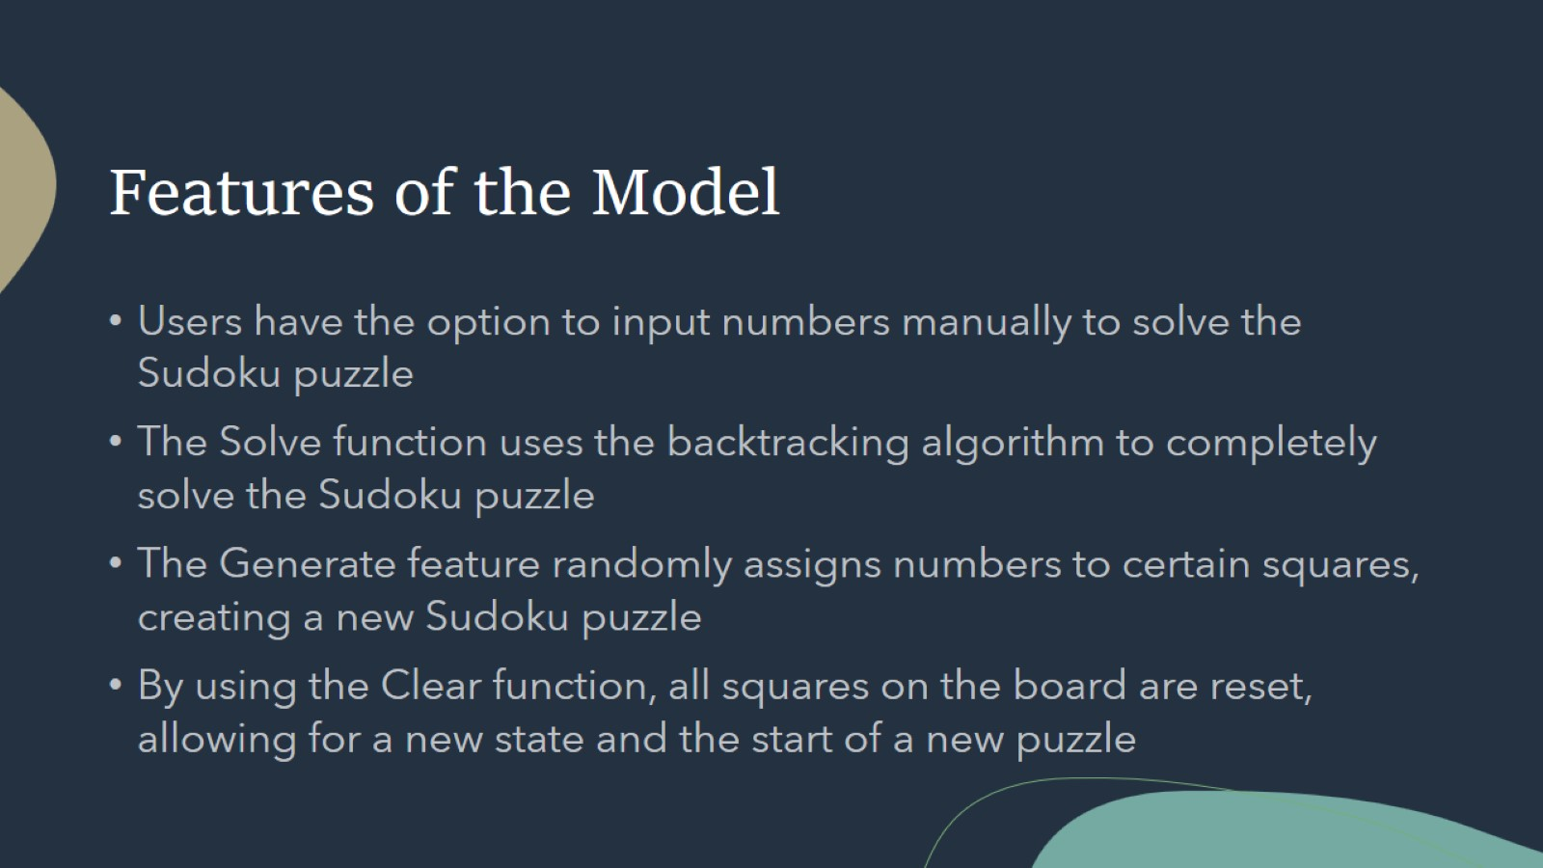
Features of the Model

Slide 8
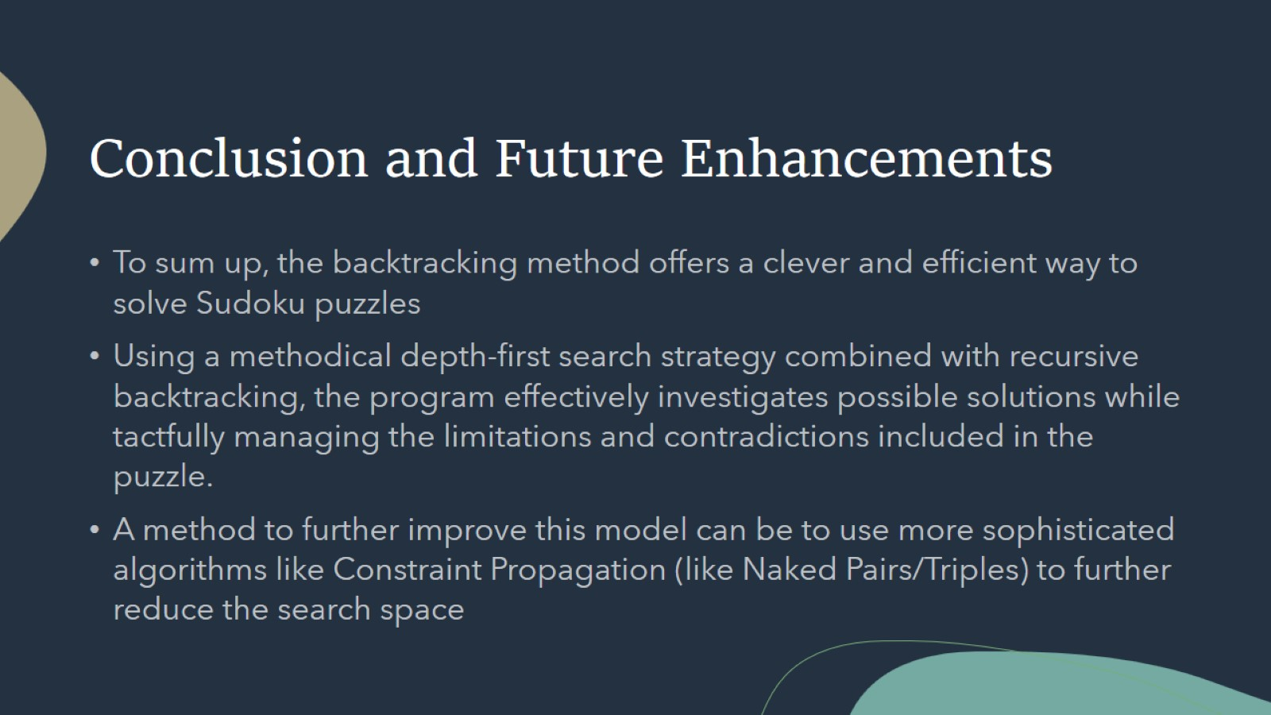
Conclusion and Future Enhancements

